Slide 1
ARTIFICIAL INTELLIGENCE-MACHINE LEARNING AND DEEP LEARNING
I

Slide 2
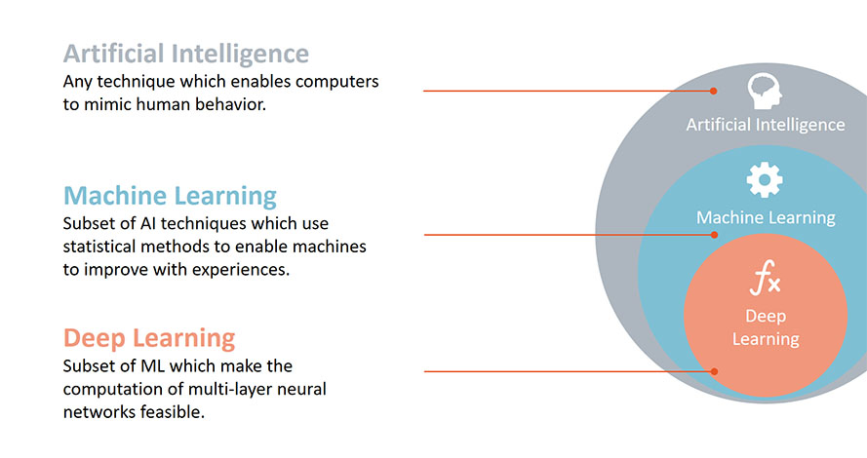
I

Slide 3
Definition
Artificial Intelligence: Artificial intelligence (AI) is the ability of a computer or a robot controlled by a computer to do tasks that are usually done by humans because they require human intelligence and discernment.
Machine Learning: It's the process of using mathematical models of data to help a computer learn without direct instruction. This enables a computer system to continue learning and improving on its own, based on experience.
Deep Learning: Deep learning is a method in artificial intelligence (AI) that teaches computers to process data in a way that is inspired by the human brain. Deep learning models can recognize complex patterns in pictures, text, sounds, and other data to produce accurate insights and predictions.

Slide 4
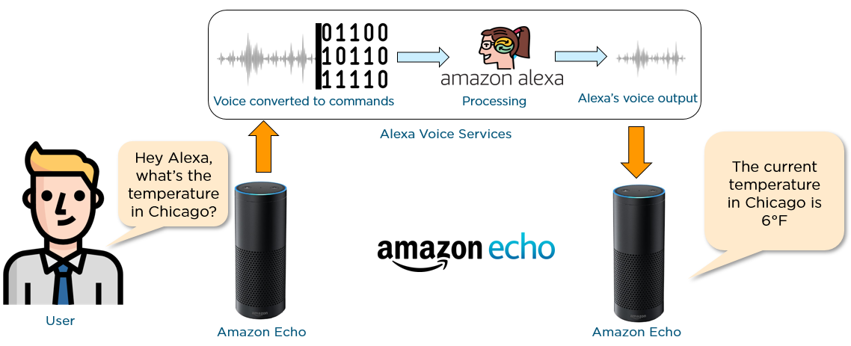
Structure of AI

Slide 5
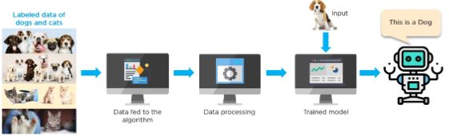
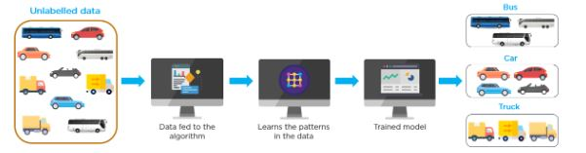
Structure of ML

Slide 6
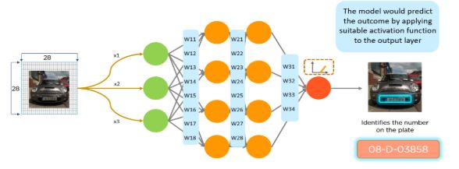
Structure of DL

Slide 7
Why is deep learning better than machine learning?
The first advantage of deep learning over machine learning is the redundancy of feature extraction.
In feature extraction we provide an abstract representation of the raw data that classic machine learning algorithms can use to perform a task (i.e. the classification of the data into several categories or classes).

Slide 8
Key features of artificial intelligence
Problem solving
AI excels at solving complex problems that involve large amounts of data and decision-making
Medical diagnosis: AI can analyze medical data and assist in diagnosing diseases by recognizing patterns and anomalies.
Optimization: AI can optimize supply chains, transportation routes, and resource allocation to improve efficiency and reduce costs.
Game playing: AI has achieved superhuman performance in chess, Go, and video games by employing advanced problem-solving techniques.

Slide 9
i
Data handling
Big Data analysis: AI is adept at handling vast amounts of data efficiently. This is essential in today's data-driven world, where businesses and organizations rely on data for decision-making and insights
Personalization: It uses customer data to provide personalized recommendations in e-commerce, content streaming, and advertising.

Slide 10
Characteristics of machine learning
Automation: Machine learning algorithms automate the process of finding patterns in data, requiring less human involvement and enabling more precise and effective analysis.
Scalability: Machine learning techniques are well suited for processing big data because they are made to handle massive amounts of data. As a result, businesses can make decisions based on information gleaned from such data.

Slide 11
Characteristics of deep learning
Supervised or unsupervised model
Huge amount of resources
Large amount of layers in model
Cost function

